Slide 1



Mai Ngo 5/29/2023 DATA ANALYSIS AND REGRESSION Project Presentation
Predictive Analysis on Data Science Salaries 2020-2023

Slide 2
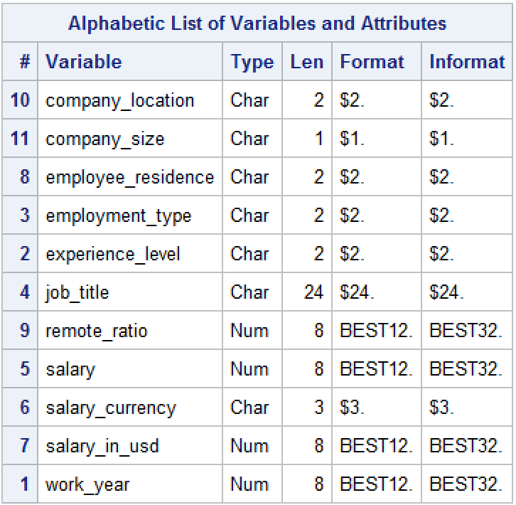
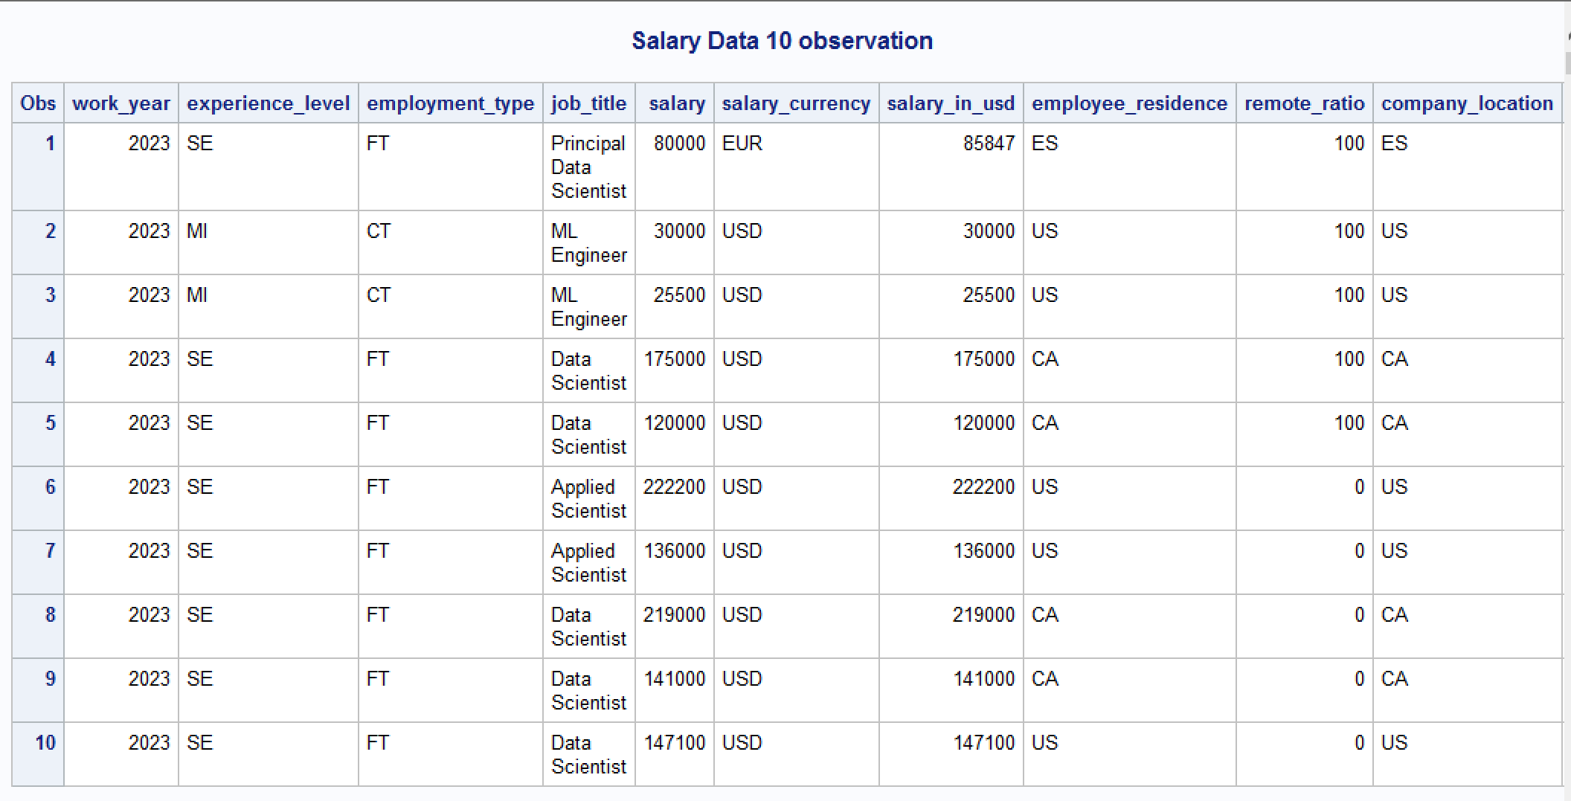
Dataset Introduction
3755 observations of Data Science field salaries worldwide from 2020 to 2023.
The dataset is from Kaggle (.csv format), and original data source is from https://salaries.ai-jobs.net/download/.
There are a total of 11 attributes: 4 numerical and 7 categorical attributes.

Slide 3
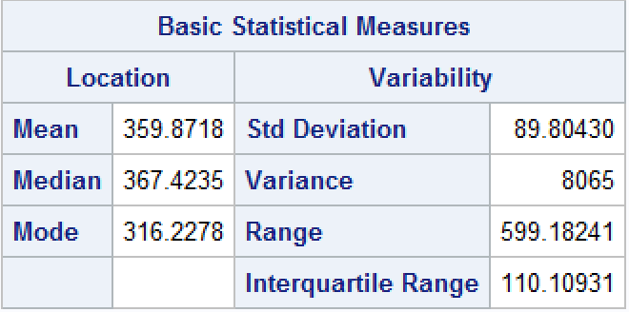
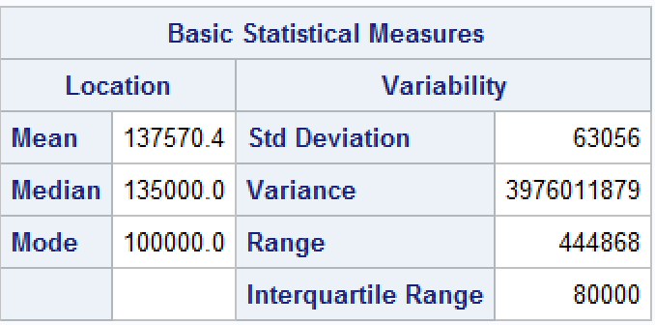
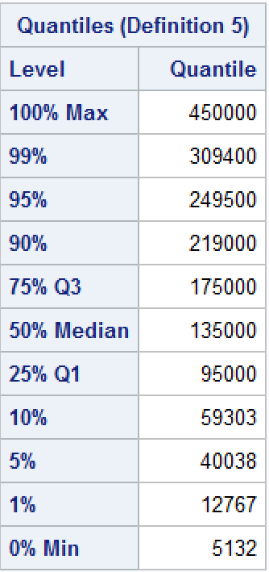
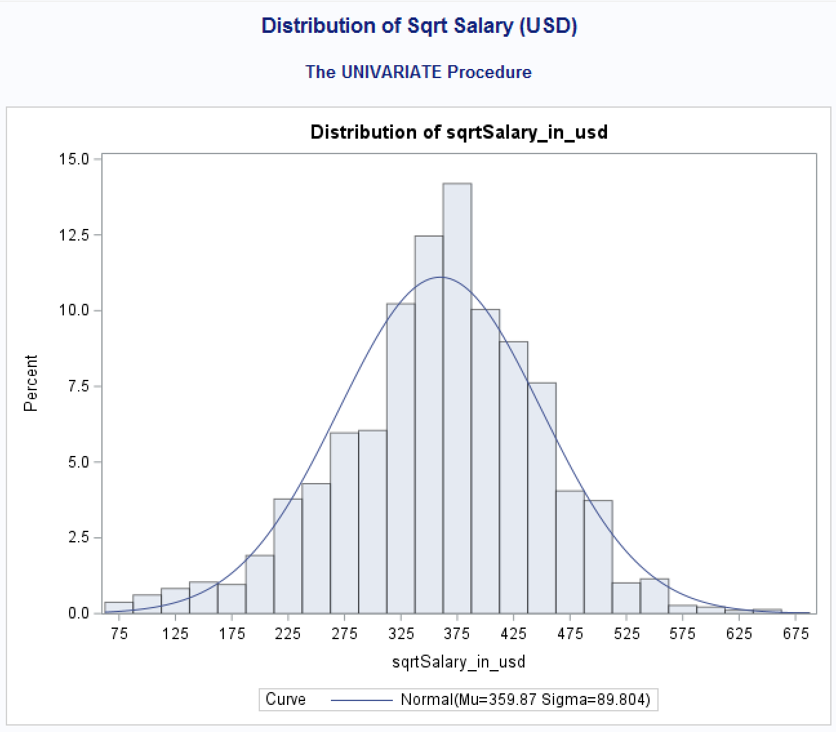
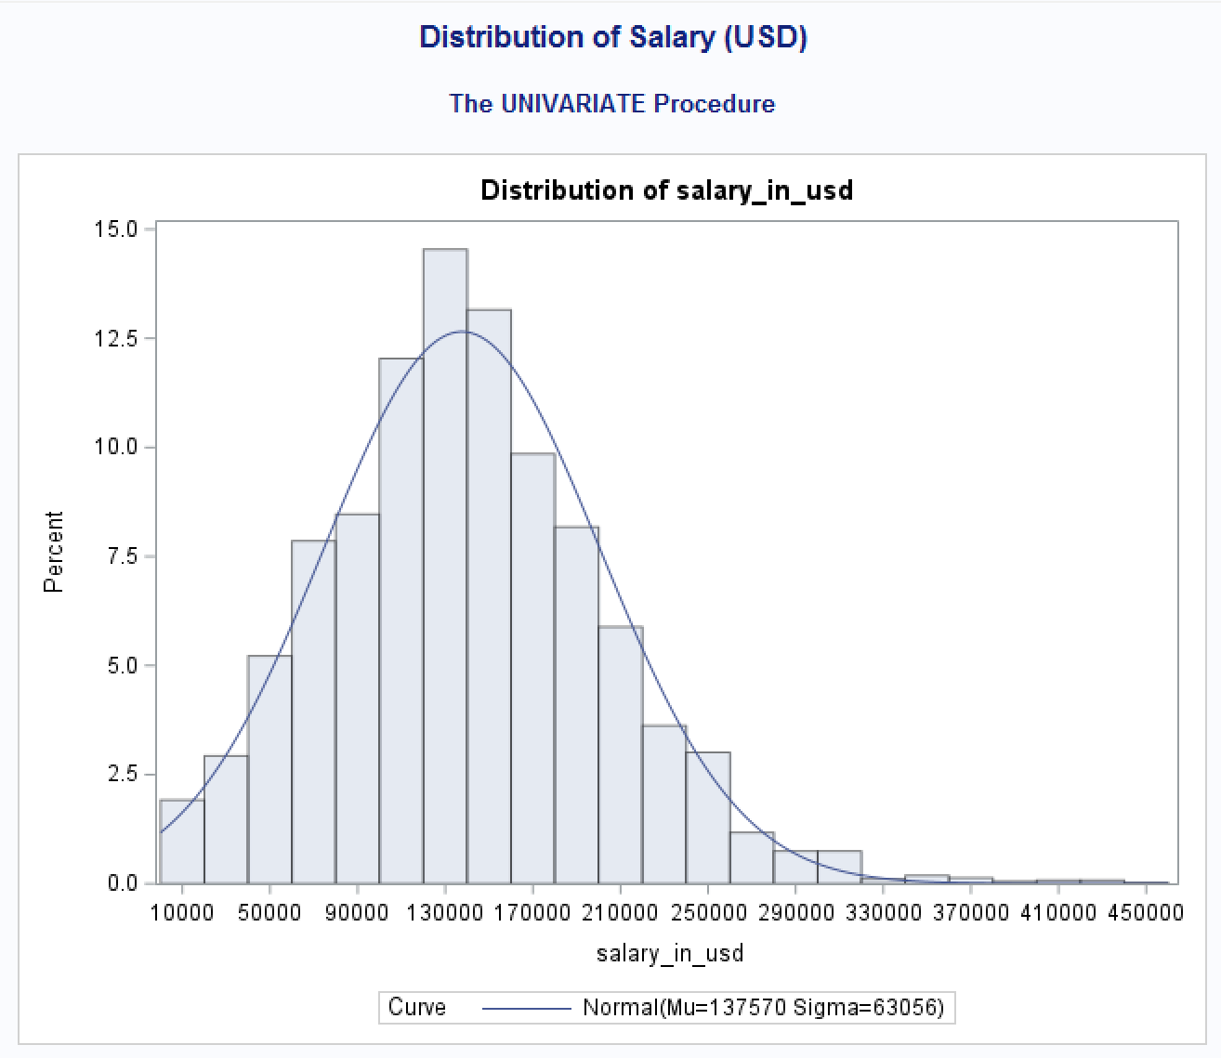
Attribute Exploratory
After square root transformation.

Slide 4
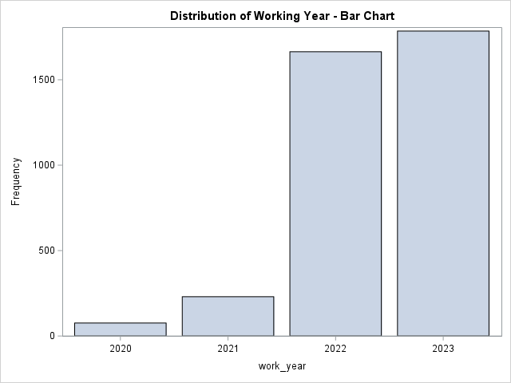
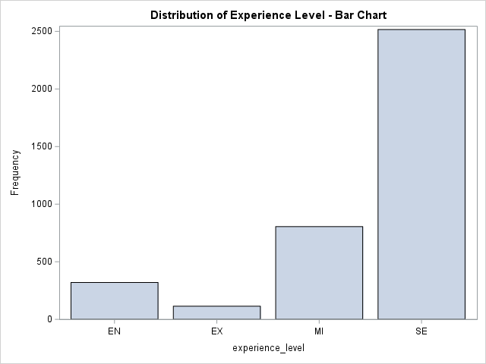
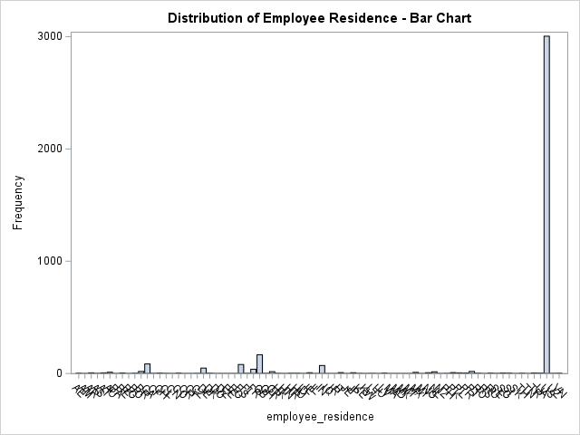
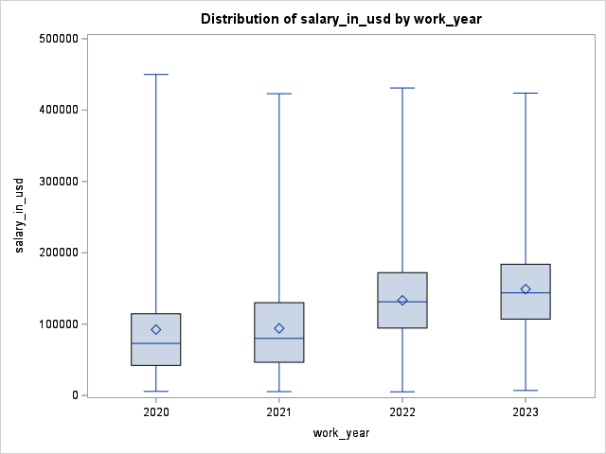
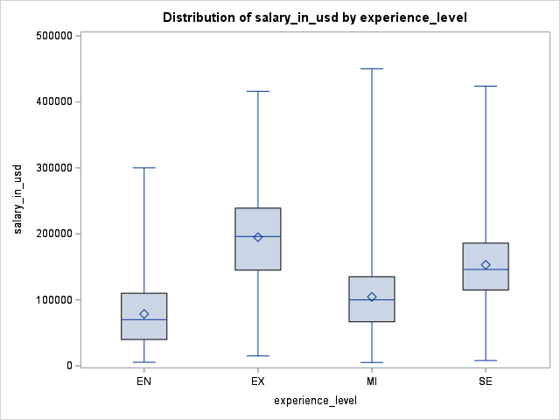
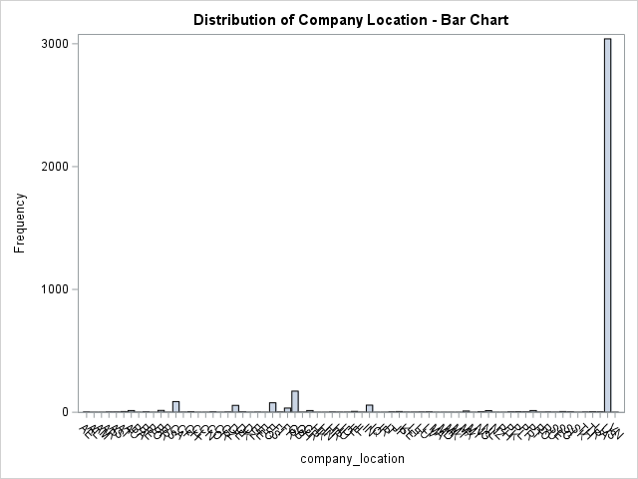
Attributes distribution.
3755 observations total.

Slide 5
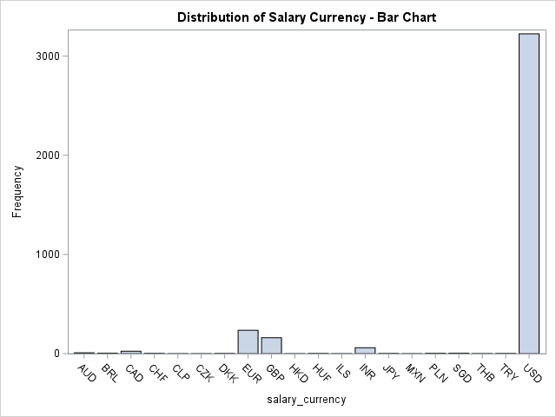
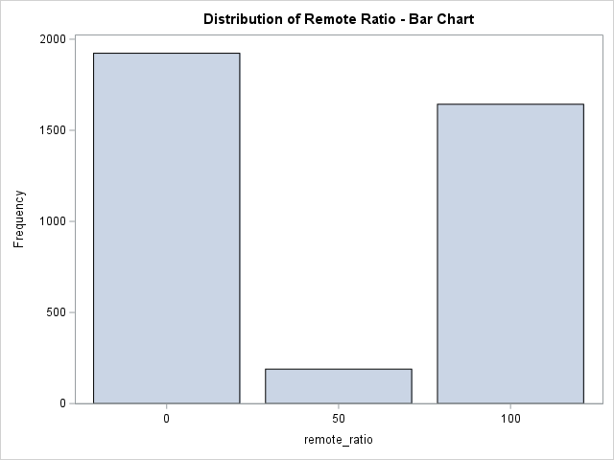
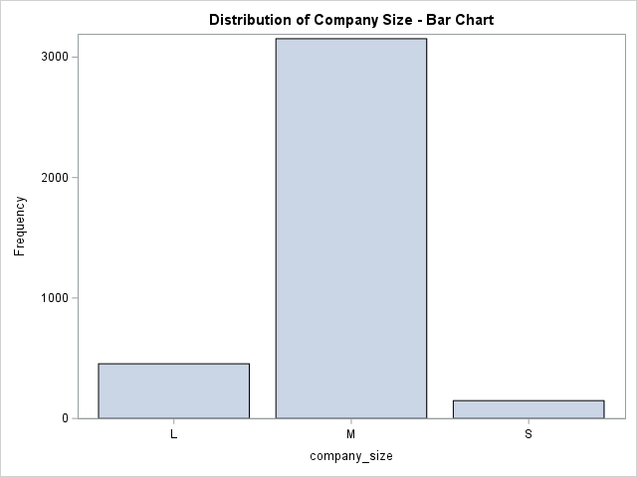
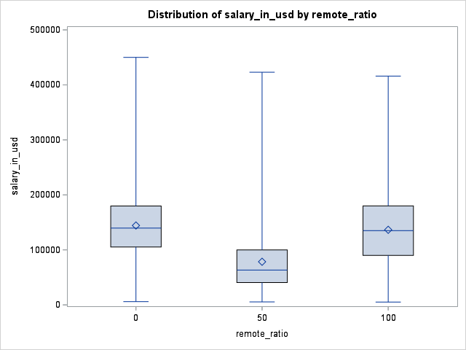
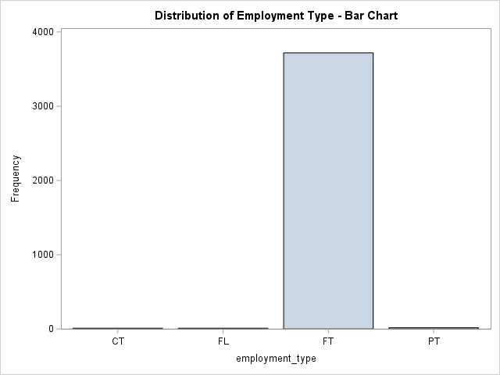
Attributes distribution (cont).
3755 observations total.

Slide 6
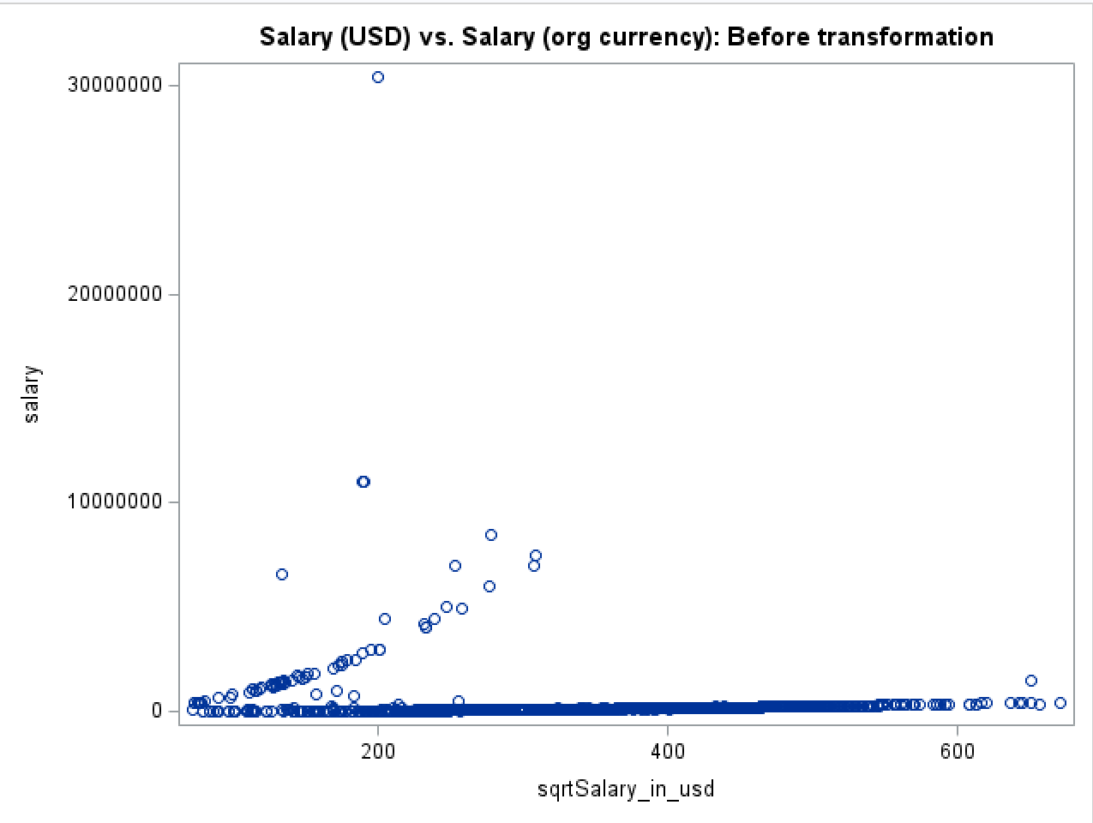
Correlation between numerical attributes.
Distinct straight flat line between the two variables. Just from the graph, changes from Salary in USD doesn’t correlate with changes from the original currency.
We can interpret that there is no consistent increase or decrease in predicted variable (salary converted in USD amount) as the predictor variable changes.
The relationship between the two variables is very weak.

Slide 7
Project Objectives
Dependent variable: Salary in USD.
Independent variable: Work Year, Experience Level, Employment Type, Salary (original currency), Salary Currency, Employee Residence, Remote Ratio, Company Location, Company Size.
Objective: predict future Data Science salaries in USD currency (continuous variable) given current pay rate (original currency) and employment condition (remote ratio, company sizes, basically all categorical attributes.)
Apply: Multiple Linear Regression.
ANOVA

Slide 8
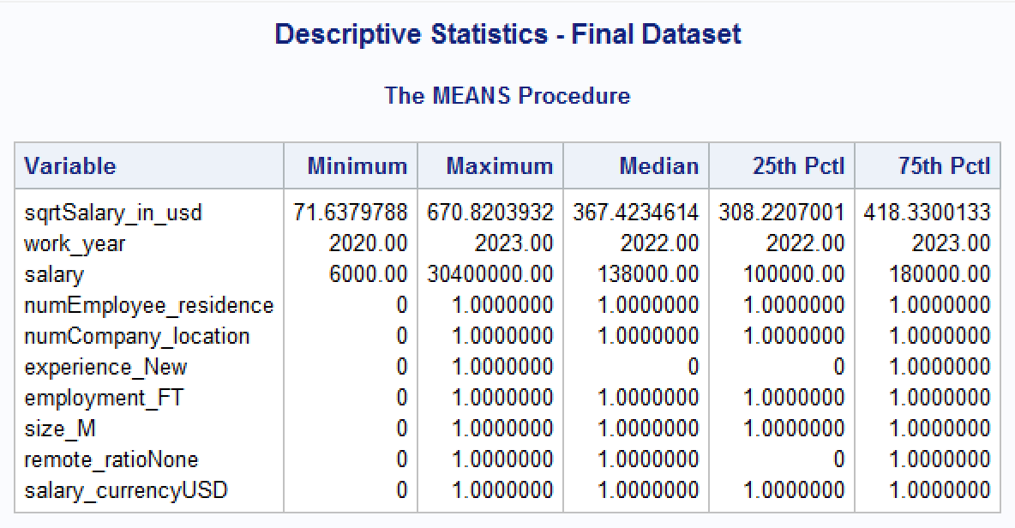
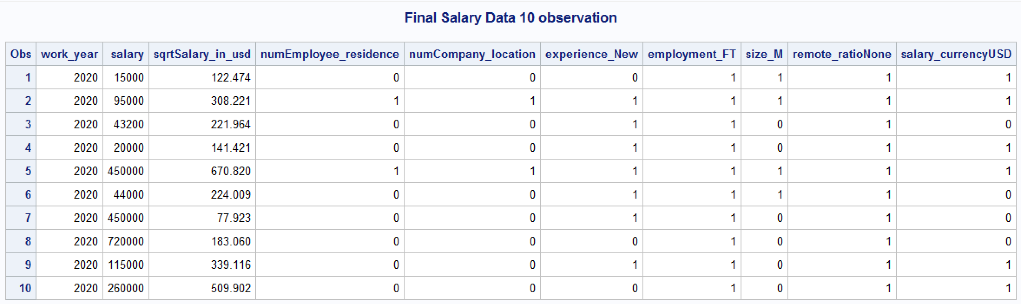
Final dataset: finalSalary.
Address data imbalance with dummy variables.
Highest frequency count.
Final dataset:
Salary and Work Year stay the same.
Square root transformation on predicted value (Salary in USD).

Slide 9
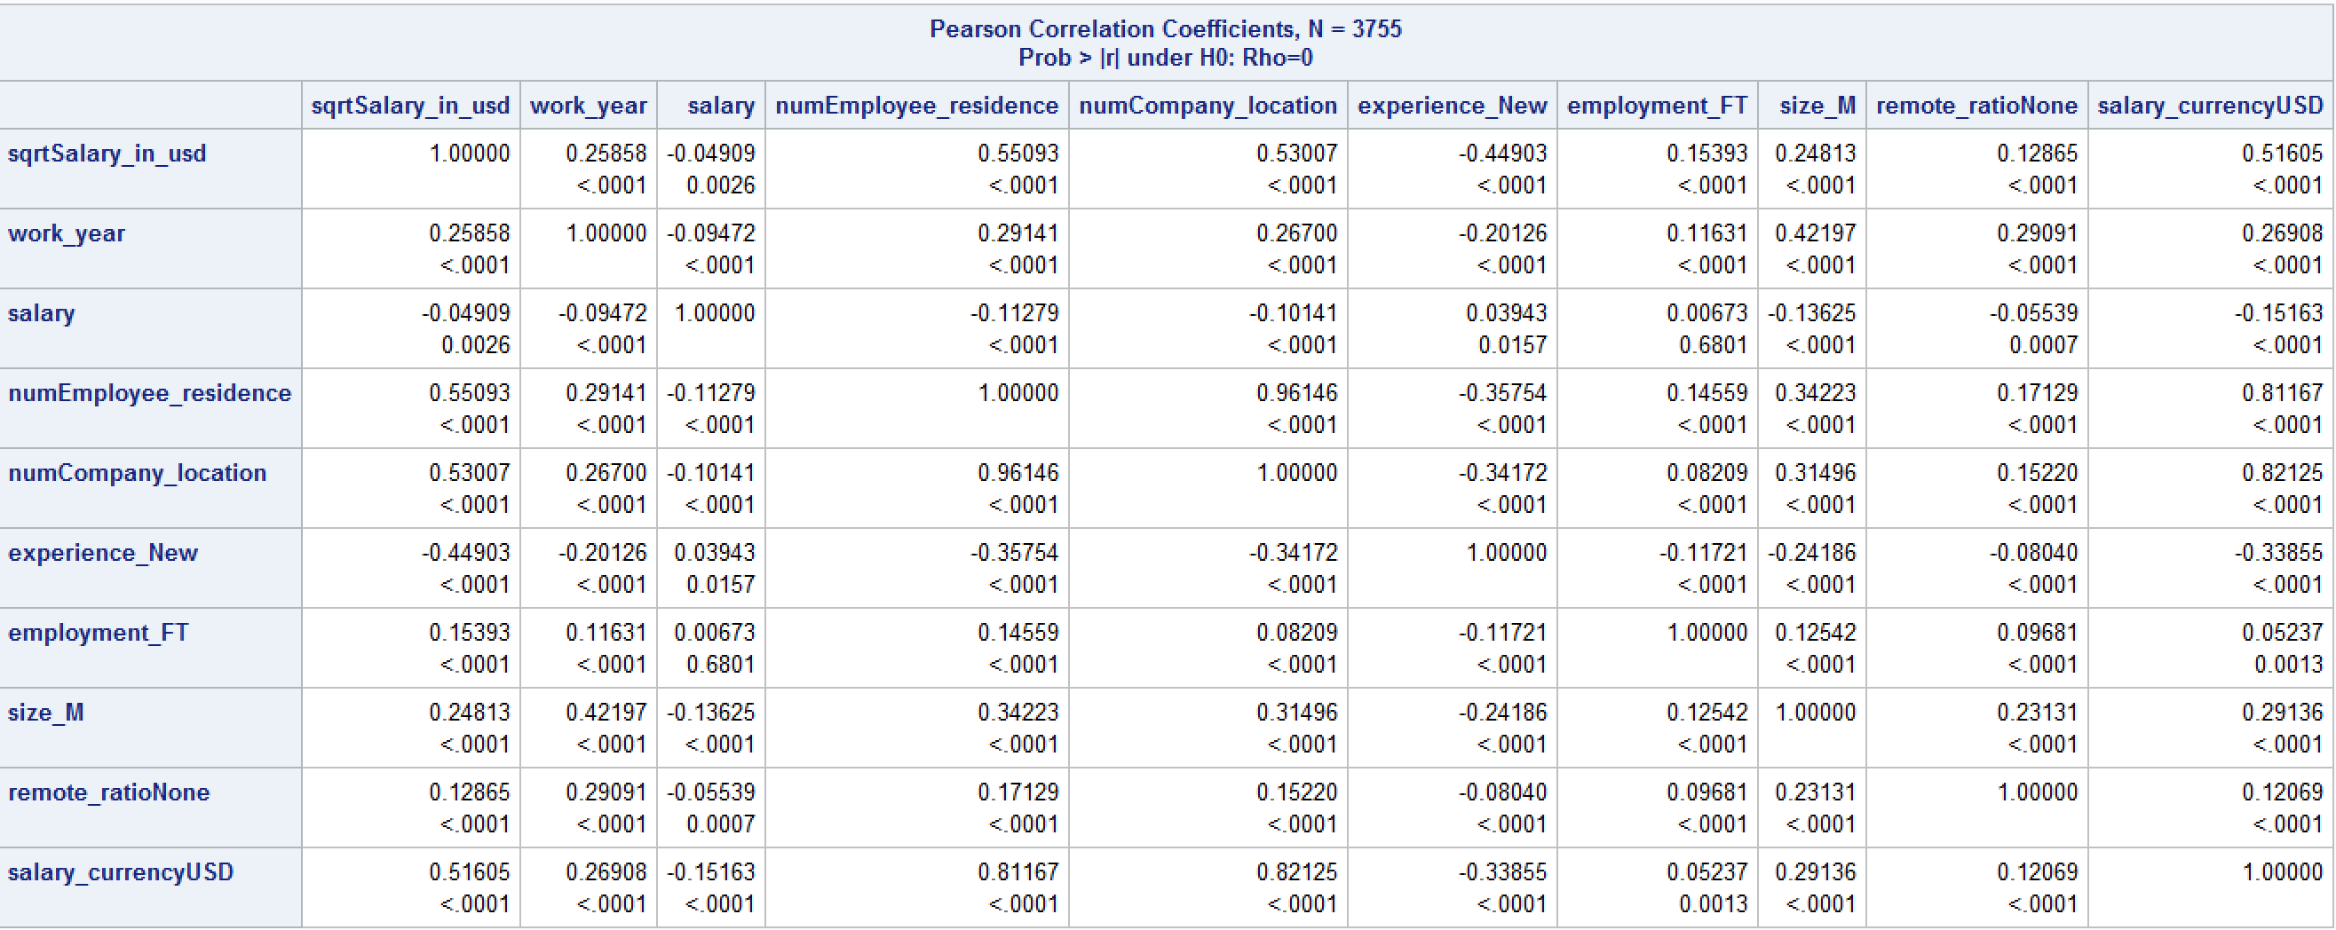
Final dataset: Descriptive Statistics and Correlations.

Slide 10
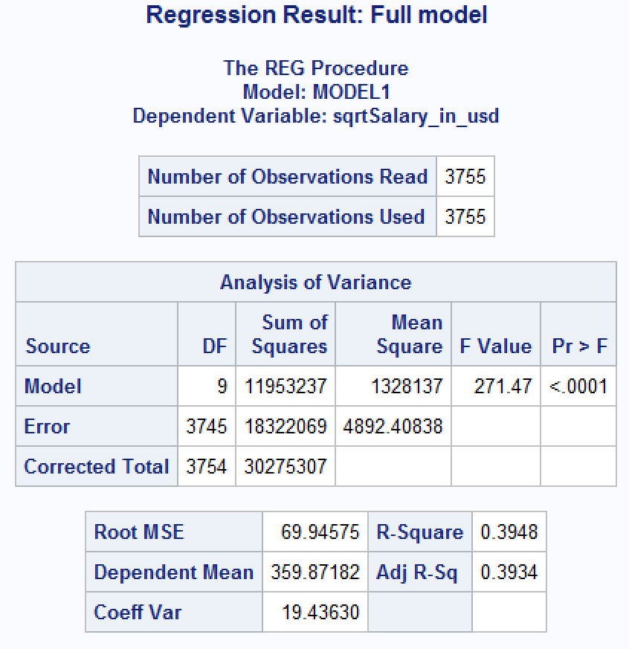
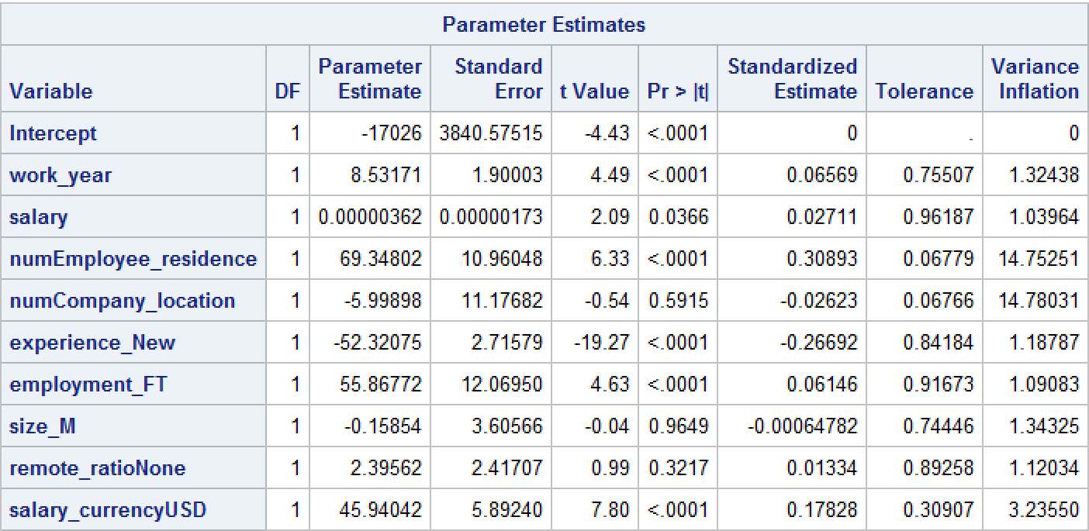
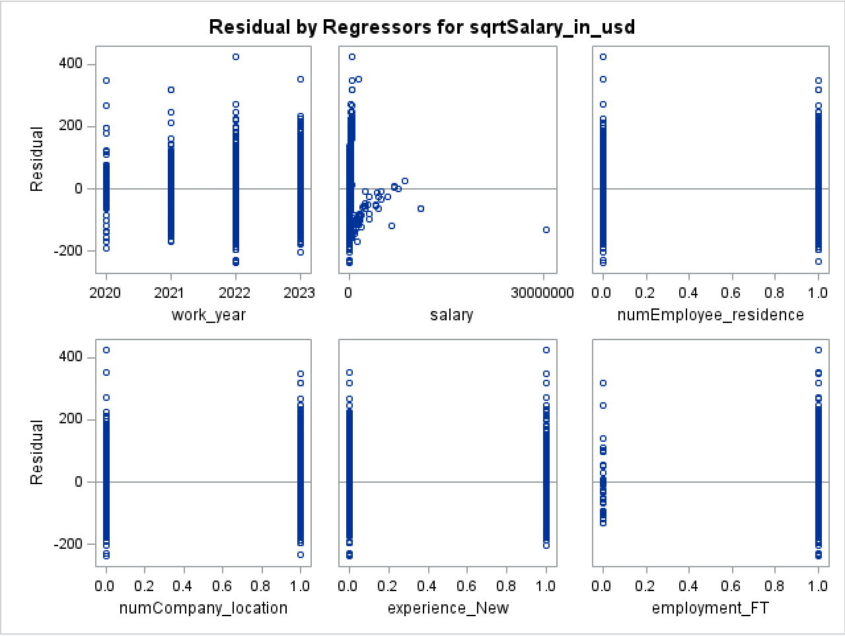
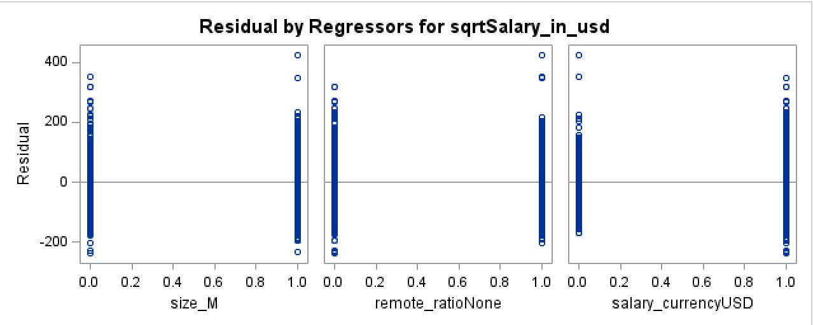
Regression result: Full model.

Slide 11
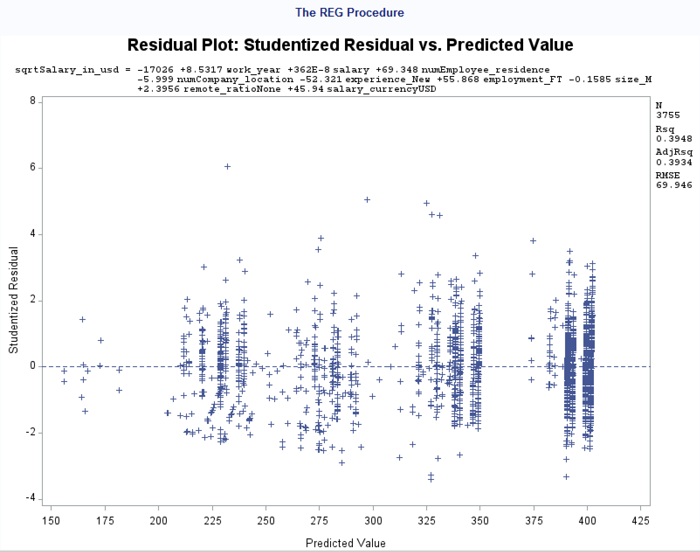
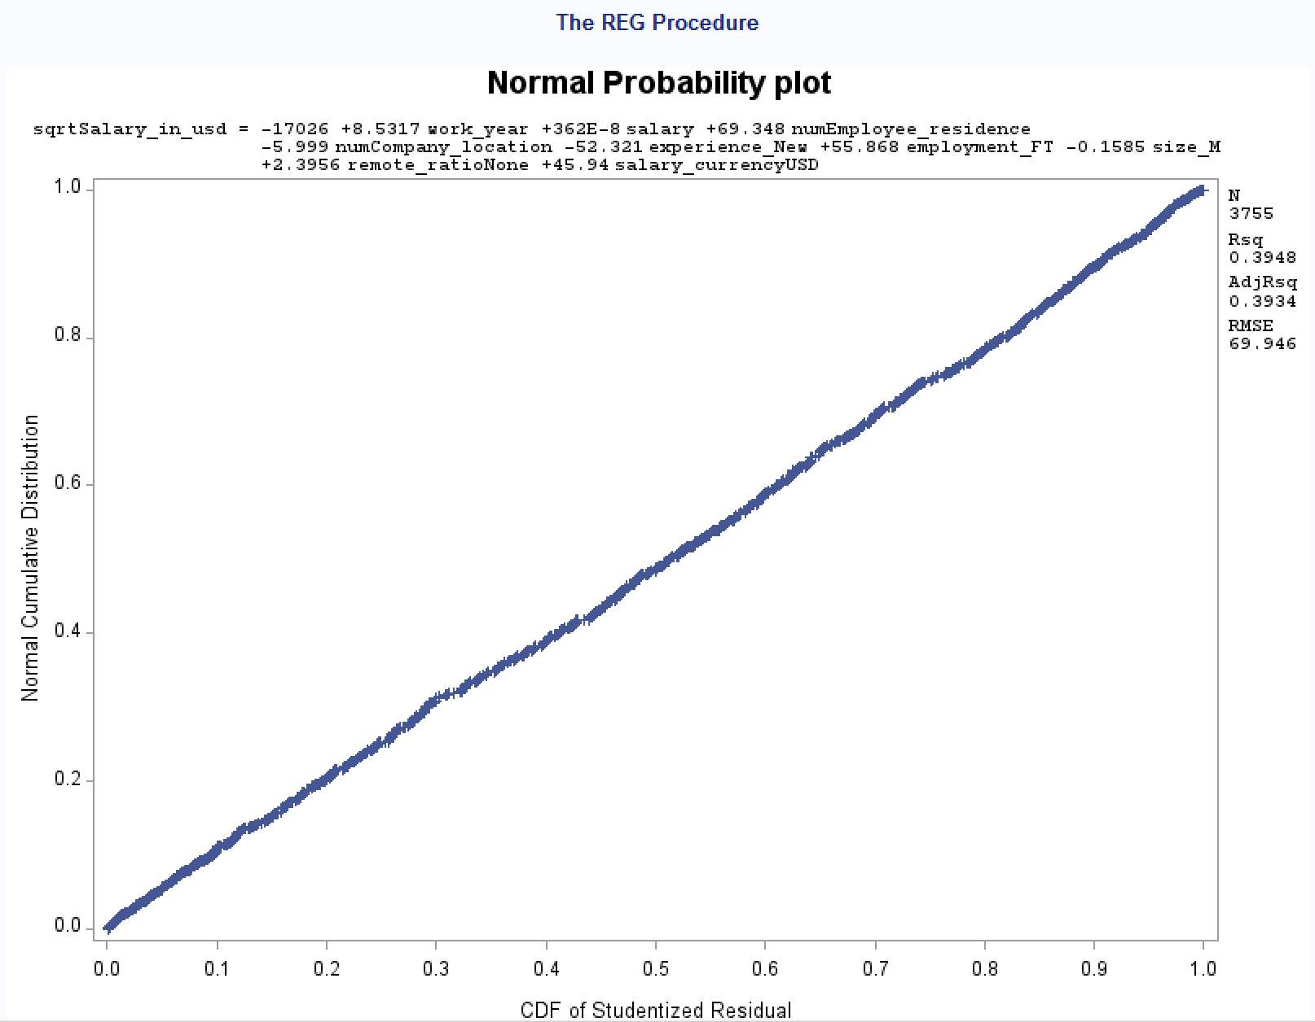
Regression result: Full model.
Regression full model:
sqrtSalary_in_USD = -17026+ 8.532 * work_year + 0.00000362 * salary + 69.348 * numEmployee_residence
-5.99 * numCompany_location – 52.32 * experience_New + 55.86 * employment_FT
-0.16 * size_M + 2.395 remote_ratioNone + 45.94 * salary_currencyUSD

Slide 12
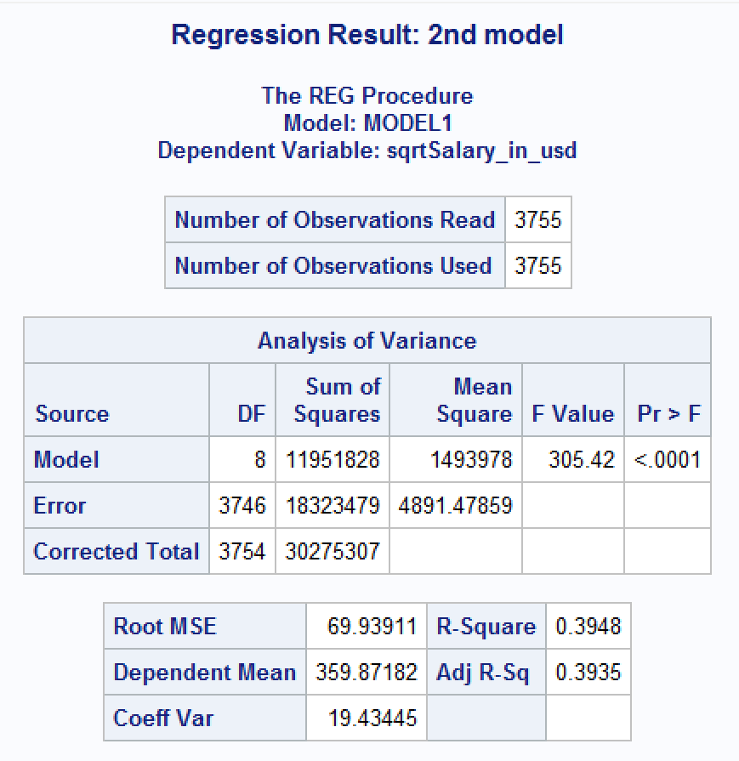
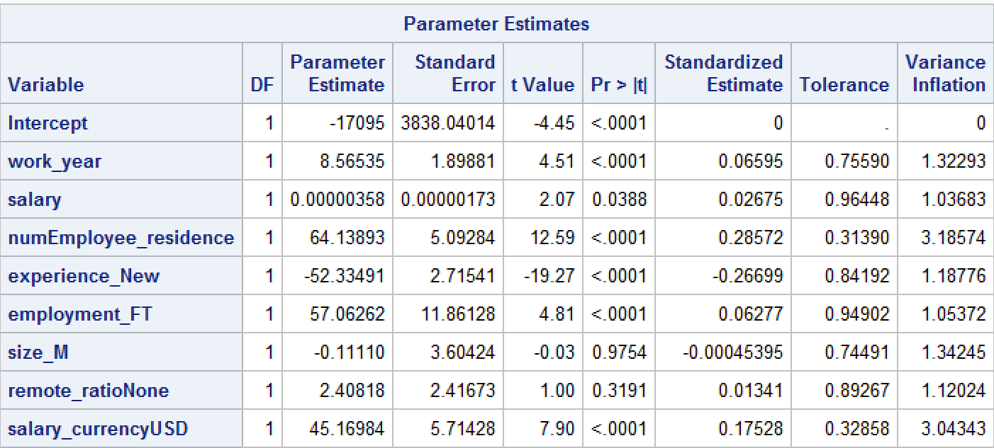
Regression result: 2nd model.
Remove numCompany_location due to multicollinearity.
R-square slight changes from 39.34% to 39.35%.
RMSE also slightly decreases from 69.94 to 69.93.
F-value also increased from 271.47 to 305.42 with significant P-value <.0001.
Company size and remote ratio still have high P-value greater than 0.05; 0.9754 and 0.3191, respectively.

Slide 13
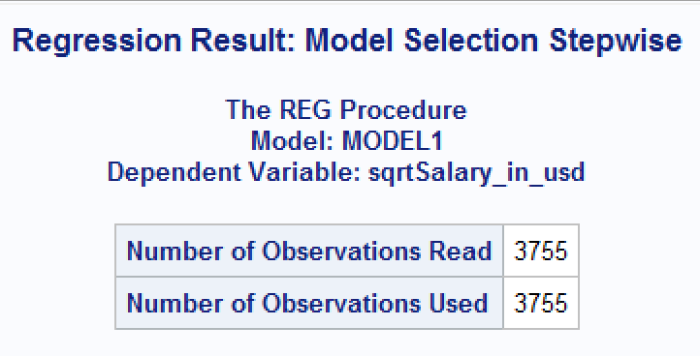
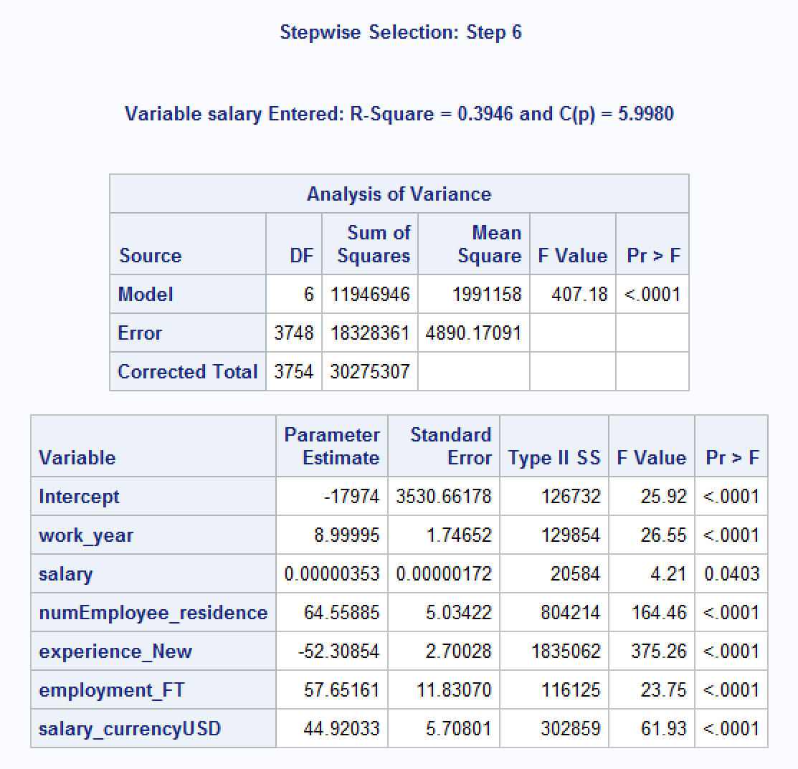
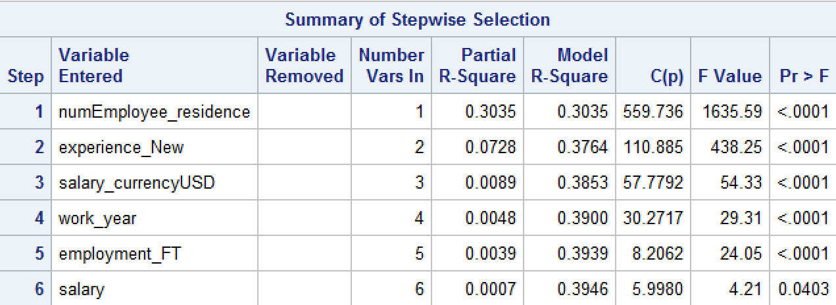
Stepwise Selection Method.
The suggested model has R-squared = 0.3946 or 39.46%. An improvement from previous model which has R-square = 39.35%.

Slide 14
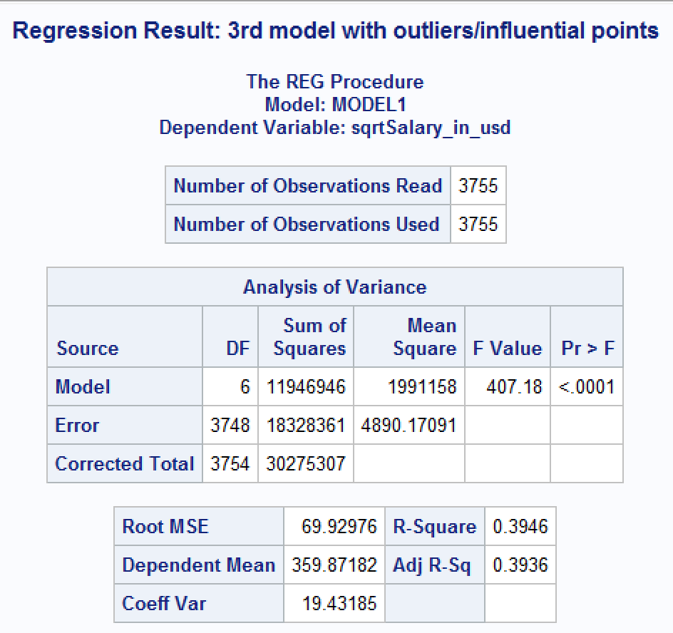
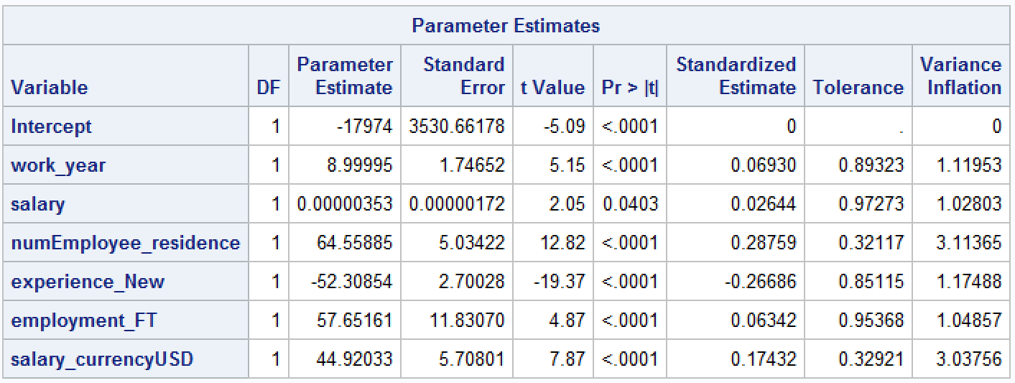
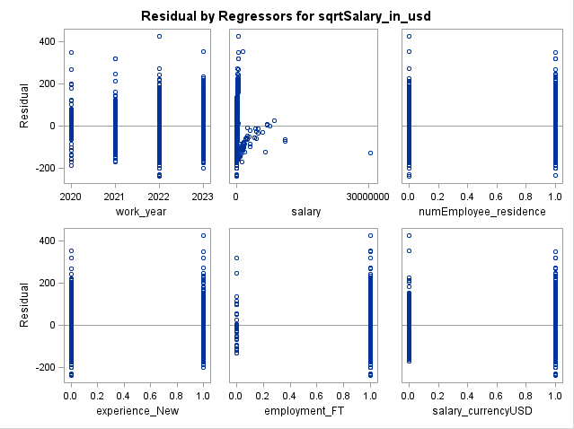
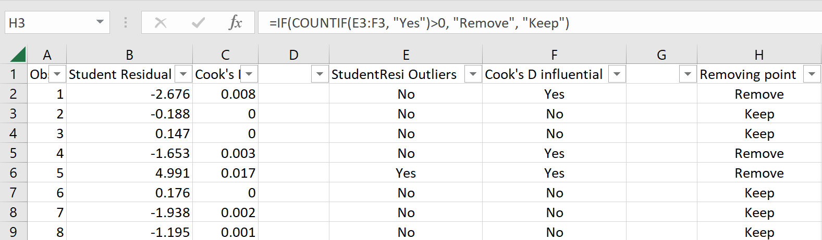
Regression result: 3rd model.
Using model from stepwise selection method.
Includes outliers and influential points.

Slide 15
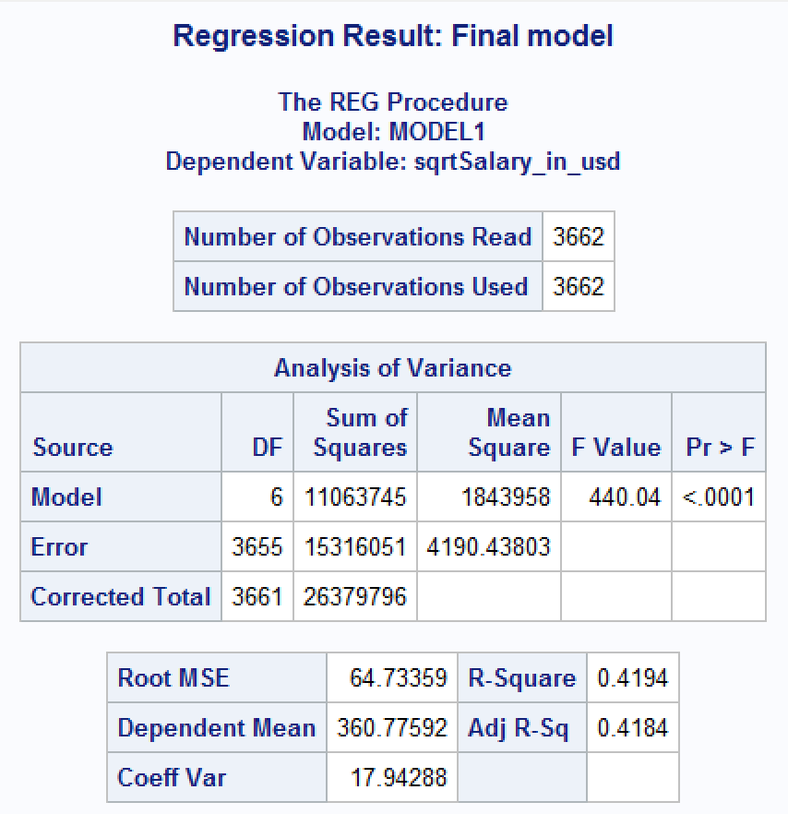
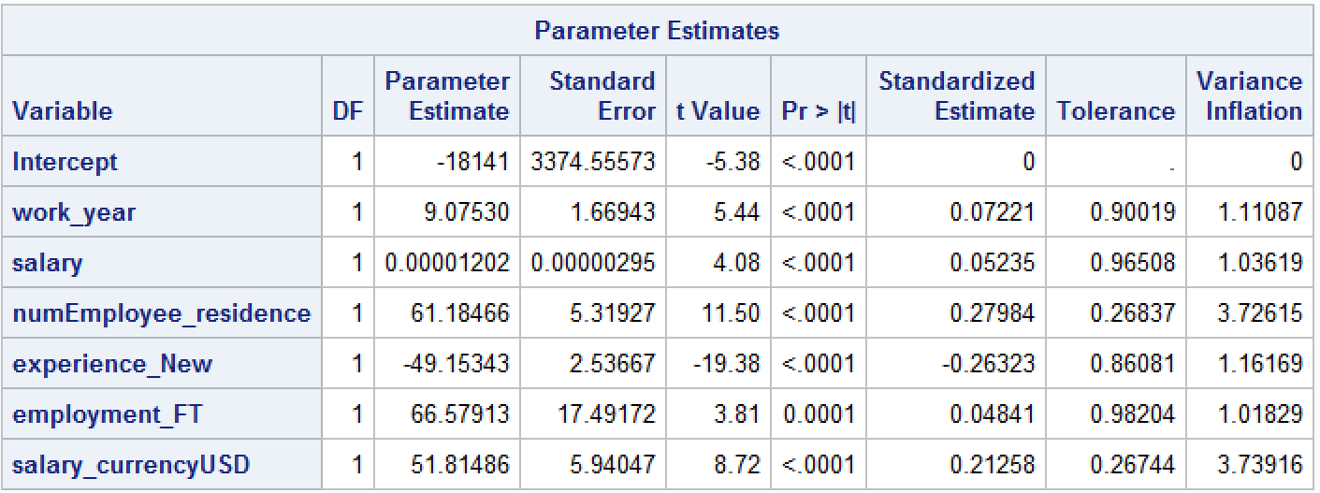
Regression result: 4th model (final model).
R-squared is now improved to 0.4184 indicates that 41.84% of the variance in the Salary in USD amount can be explained by the six predictors.
F-value increased from 305.42 to 440.04 with significant P-value <.0001.
Root MSE also reduced from 69.93 to 64.733.
Regression full model:
sqrtSalary_in_USD = -18141 + 9.075 * work_year + 0.00001202 * salary + 61.185 * numEmployee_residence
– 49.153 * experience_New + 66.58 * employment_FT + 51.814* salary_currencyUSD

Slide 16
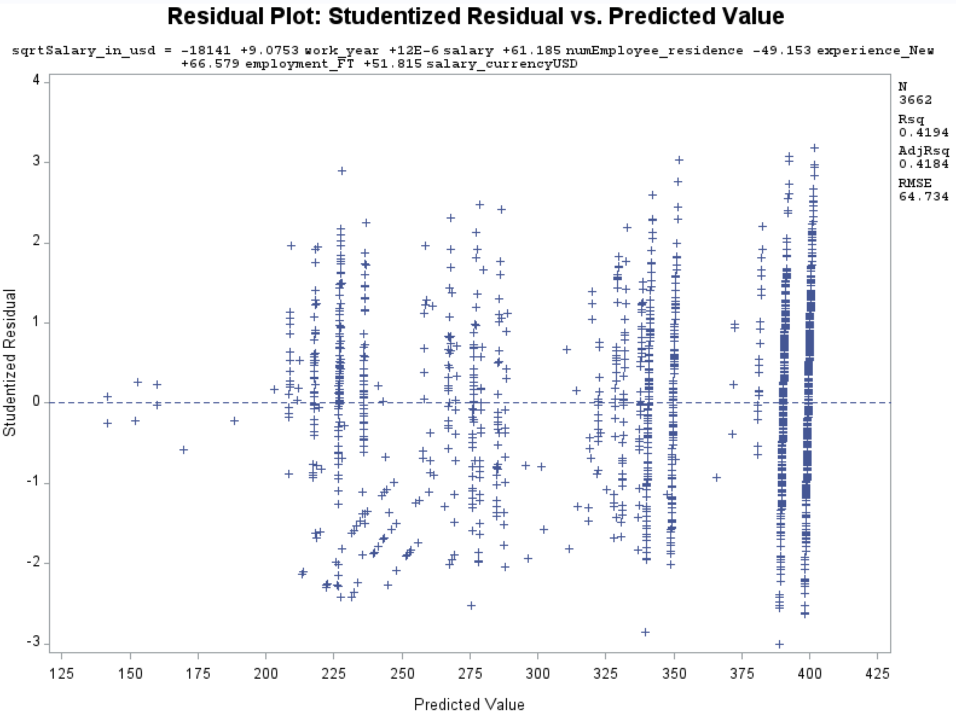
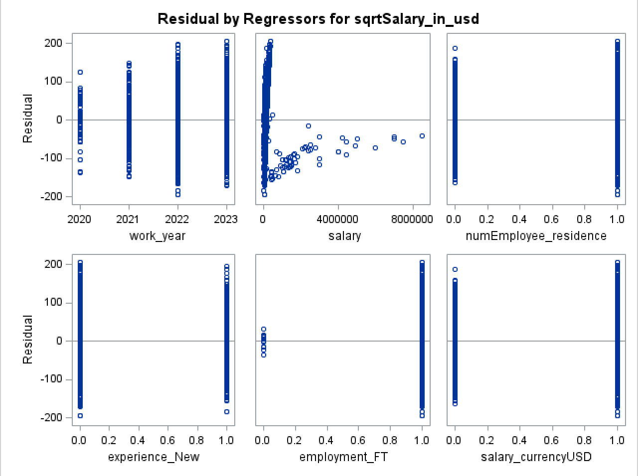
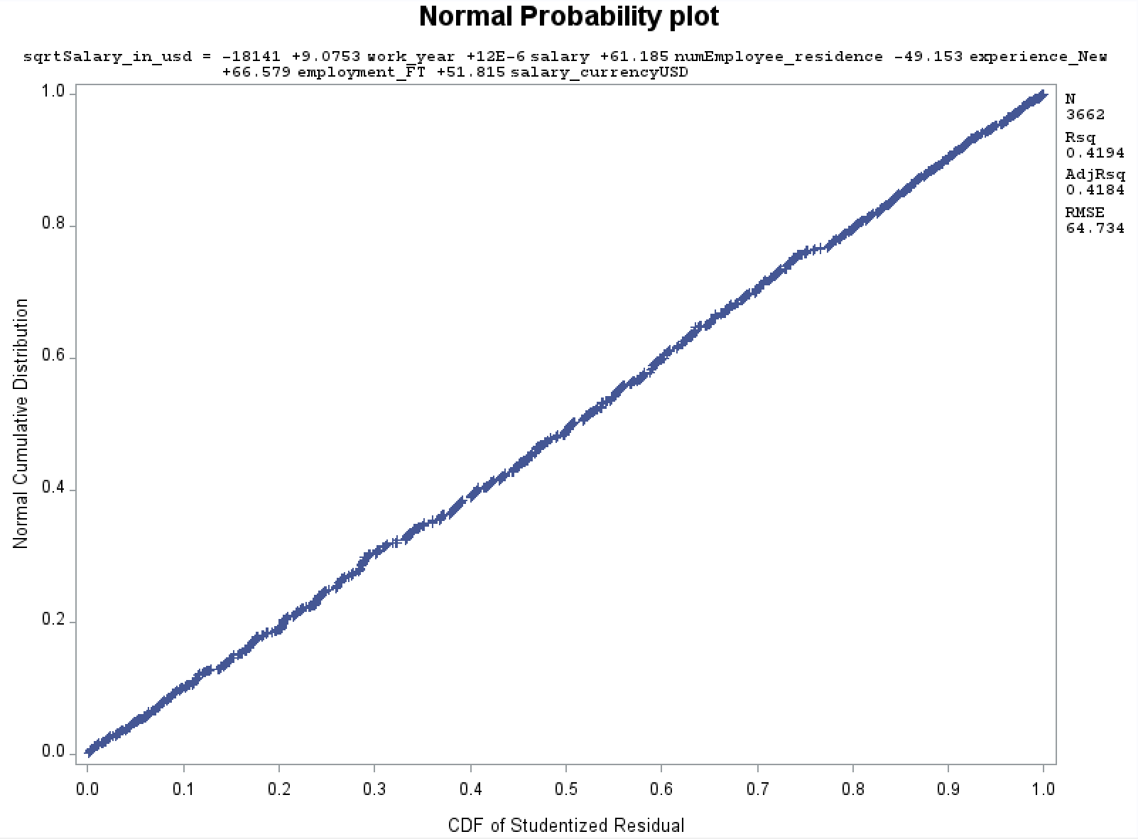
Regression result: Final model (studentized residuals).

Slide 17
Regression result: Final model (F-test).
Regression model:
sqrtSalary_in_USD = βₒ + β₁*work_year + β₂*salary (original currency) + β₃*numEmployee_residence
+ β₄*experience_New + β₅*employment_FT + β₆*salary_currencyUSD
for: β₀ = Intercept.
β₁ = Coefficient for Work Year attribute.
β₂ = Coefficient for Salary (original currency) attribute.
β₃ = Coefficient for Employee Residence attribute.
β₄ = Coefficient for Experience Level attribute.
β₅ = Coefficient for Employment Type attribute.
β₆ = Coefficient for Salary Currency attribute.
Test hypothesis
Null hypothesis: Neither of the six attributes have any association with Salary in USD attribute.
H₀: β₁ = β₂ = β₃ = β₄ = β₅ = β₆ = 0
Alternative hypothesis: At least one attribute has a significant effect on changes in Salary in USD attribute.
Hₐ: At least one of β₁, β₂, β₃, β₄, β₅, β₆ ≠ 0

Slide 18
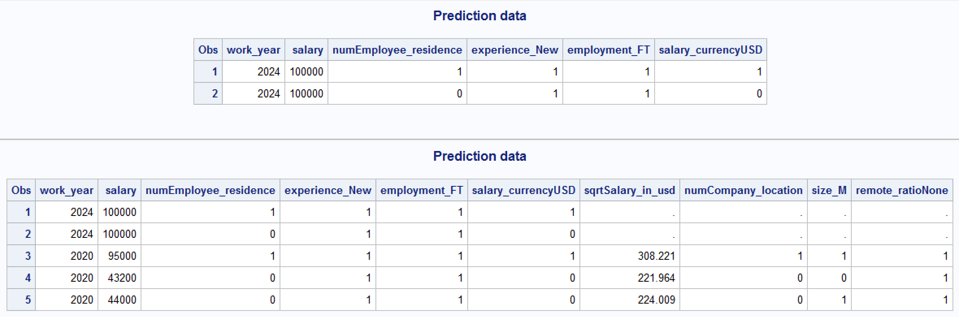
Prediction data.
The first prediction is for a person who lives in the US and gets paid by USD.
The second prediction is for a person who lives outside the US and gets paid by their local currency.

Slide 19
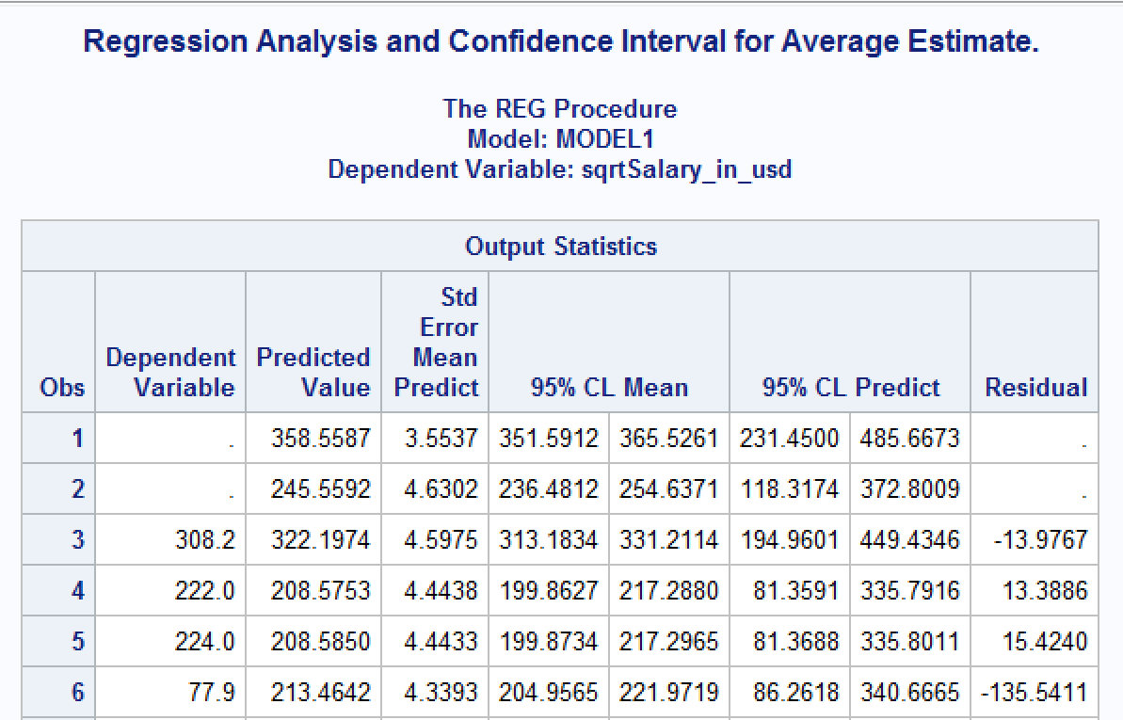
Regression result: Prediction.
First prediction: with given values, the predicted sqrtSalary_in_USD is 358.5587, approximately $128,564.34.
The 95% confidence interval range from 351.5912 to 365.5261; or $123,616.37 to $133,609.33.
Prediction intervals range from 231.45 to 485.6673; or $53,569.1 – $235,872.72. Therefore, we can conclude that the predicted value falls within the 95% confidence interval.

Slide 20
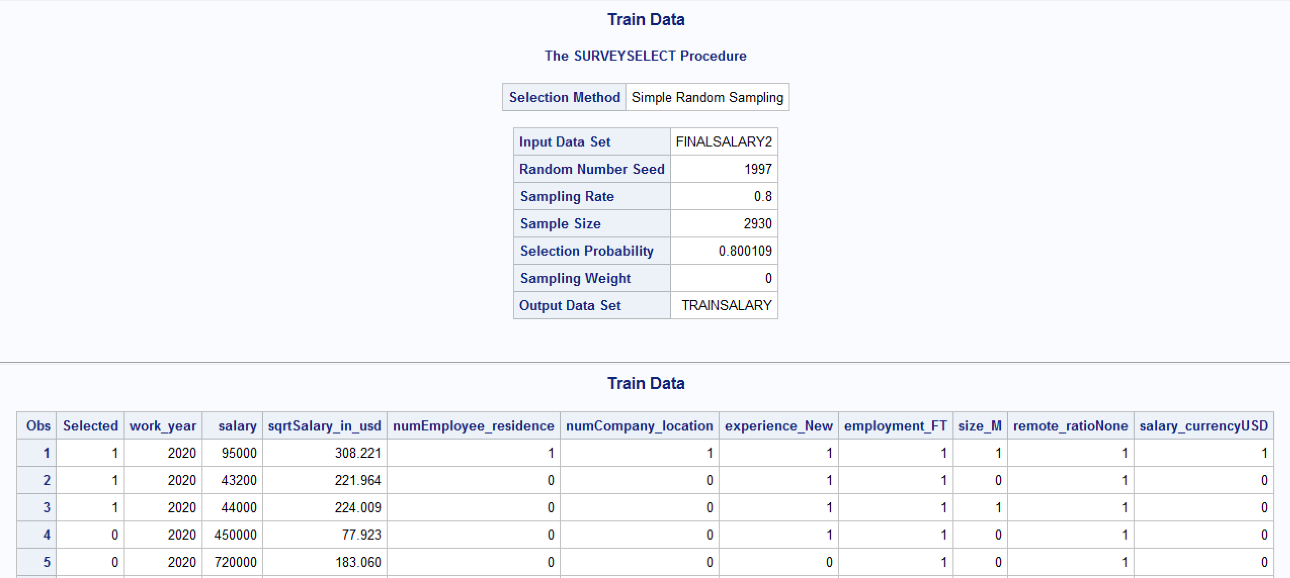
Validation: Split train-test data (80/20).

Slide 21
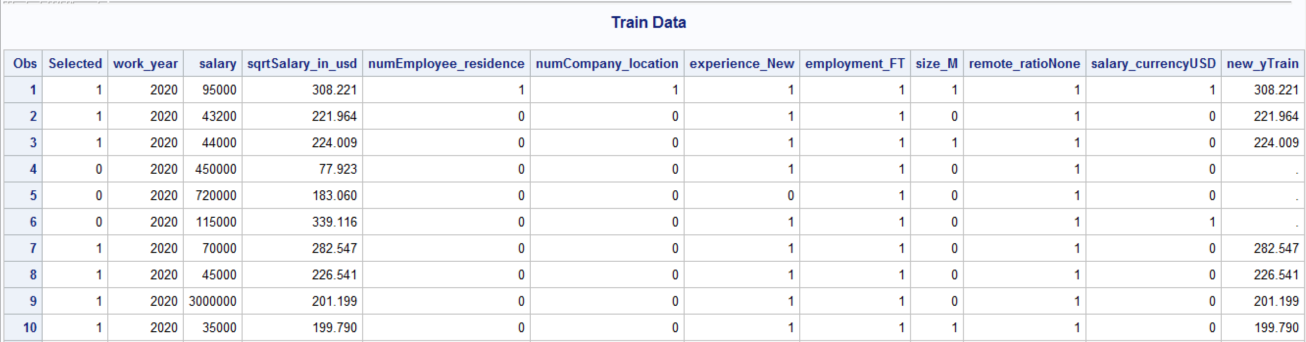
Validation: Create new DV for train data.
Creating new predicted variable for training data called new_yTrain.
Furthermore, with Multiple Linear Regression, we will not be able to generate confusion matrix since it’s only applicable for classification. Therefore, we will check model performance based on RMSE.

Slide 22
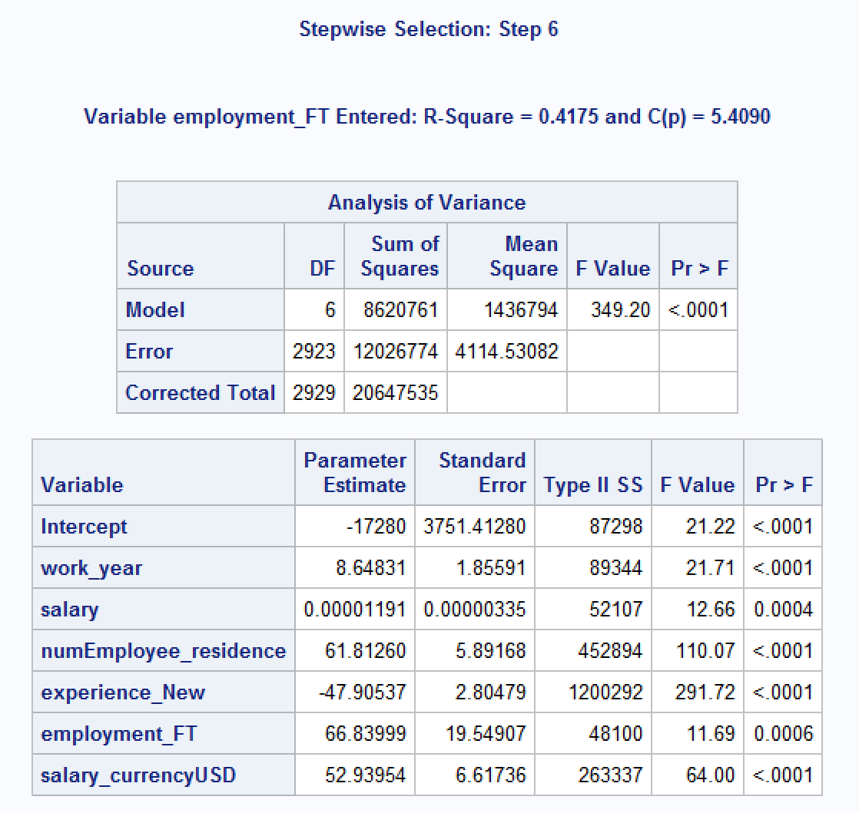
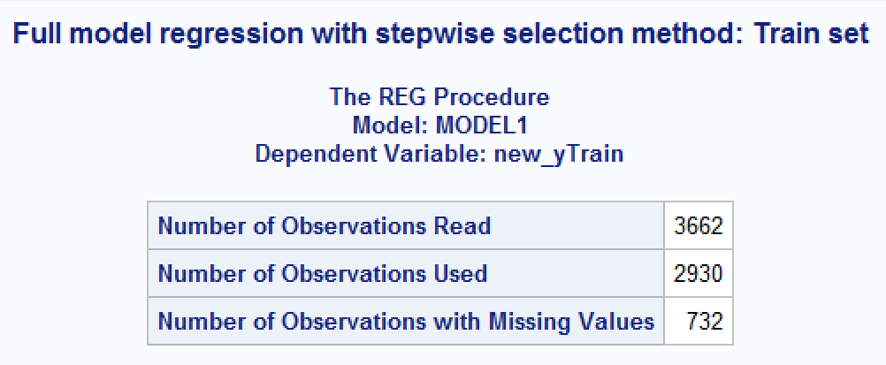
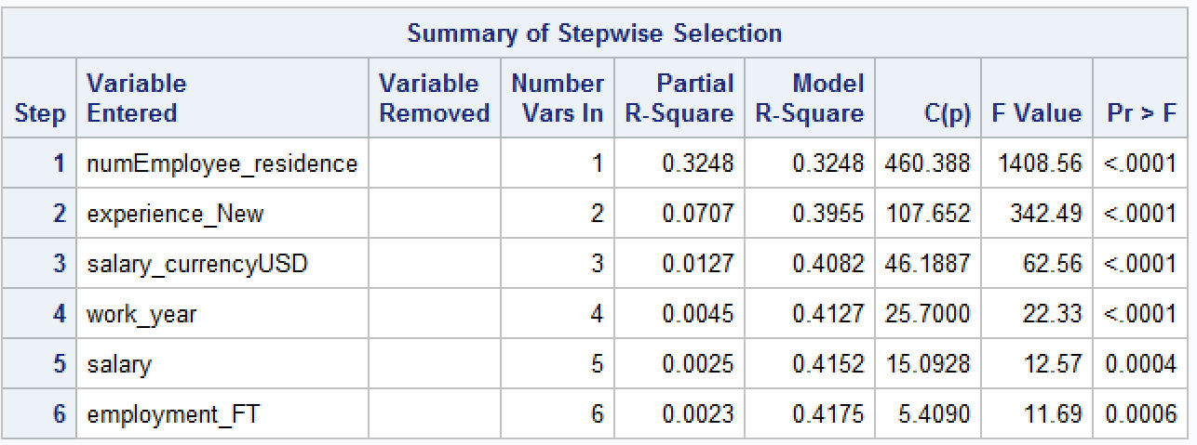
Validation: Double confirmation final model.

Slide 23
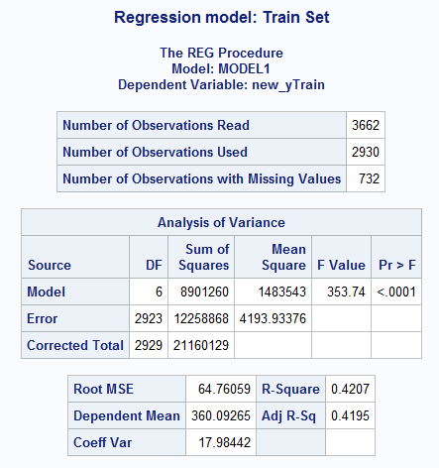

Regression result: Train set.
RMSE on train data = 64.76059

Slide 24

Validation: Create new DV for test data.
Creating new predicted variable for test data called new_yTest.

Slide 25


Regression result: Test set.
RMSE on test data 64.75384

Slide 26
Conclusion.
Not the best model for the dataset. More room for improvement of the model. Includes Job Title (dataset expansion, text categorization, parameter tuning, currency conversion / inflation rate).
Learning outcome: Based on the dataset, majority of the data corresponds to US employees in terms of salary and company. The data indicates that US employees tend to receive higher pay and experience higher career growth compared to employees outside of the US.
This observation aligns with the fact that the United States has a rapid growth rate in STEM, machine learning, and the tech industry. The US is known for providing growth opportunities and better salaries, which attracts tech workers from around the world.

